Slide 1
CLEMENTS HS WORLD LANGUAGES DEPARTMENT
WELCOME! BIENVENUE! BENVENUTUS!
¡BIENVENIDOS! WILLKOMMEN! HUANYING
SALVETE! YOKOSO!

Slide 2
LANGUAGES OFFERED
AMERICAN SIGN LANGUAGE
CHINESE
FRENCH
GERMAN
JAPANESE
LATIN
SPANISH
MS. CAMPBELL
MS. WANG AND MS. LI
MS. JONGEJAN
MS. DAVIS
MS. SHERIDAN
MR. WELLS
MS. ACEVEDO, MS. FLORES, MS. MALDONADO, MR. MORENO, MS. RODRIGUES

Slide 3
AMERICAN SIGN LANGUAGE
Level I
Level II
Level III
All levels focus on the three modes of communication: Interpersonal, Interpretive and Presentational
Organizations: ASL Club
ASL Video

Slide 4
CHINESE
Chinese Classes at CHS
Chinese NSP (Chinese for Chinese Speakers)—a beginner class for students who have some foundation in the language. Students placed into this class earn both Chinese 1 and 2 credits during freshman year.
Chinese 1—A beginner class
Chinese 2—After completing Chinese 1
Chinese 3 AAC—After completing Chinese 1 and 2 or Chinese NSP
Chinese 4 AP—After completing Chinese 3 AAC
Organizations: Mandarin Club; National Chinese Honor Society

Slide 5
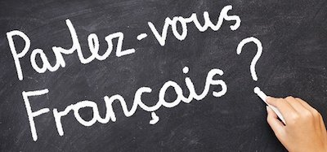
FRENCH
FRENCH Classes at CHS
FRENCH 1—A beginner class
FRENCH 2—After completing FRENCH 1
FRENCH 3 AAC—After completing FRENCH 1&2
FRENCH 4 AP—After completing FRENCH 3 Pre-AP
Organizations: French Club; National French Honor Society
Video French
Participation in Texas French Symposium and compete

Slide 6
GERMAN
German I (usually 2 sections)
German II (usually 2 sections)
German III (Advanced Academic Course) (1 section)
German IV (AP) (1 section)
One teacher all 4 years
Teacher and students grow together as a "family" as they progress through the levels each year.
Germany/Austria/Switzerland are economic, scientific, and technological powerhouses with rich cultures as well.
Very active German Club and German National Honor Society (lots of fun after-school and weekend events and field trips!)
Participation in regional and state German contests
Exchange program with a high school in Cologne, Germany!
Video (0:36)

Slide 7
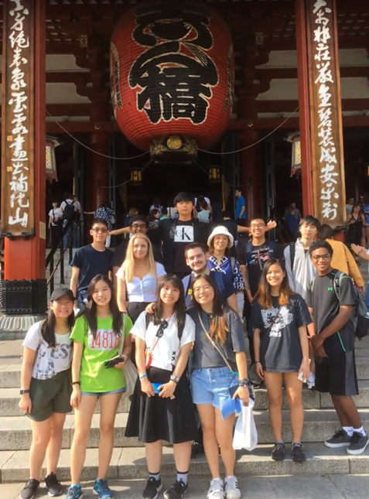
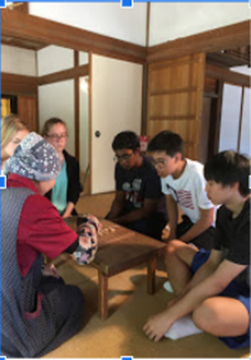
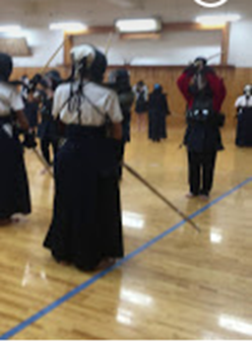
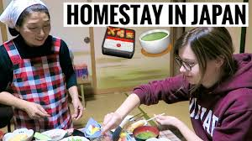
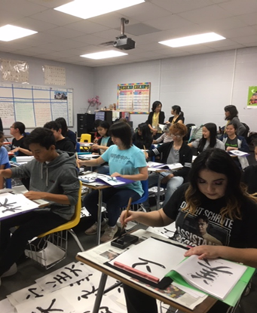
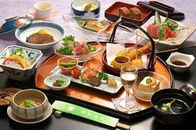
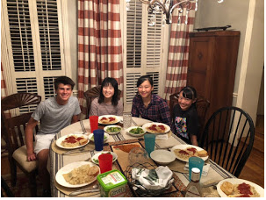
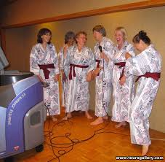
JAPANESE
Japanese I
Japanese II
Japanese III Pre-AP (1 section)
Japanese IV AP (1 section)
One teacher all 4 years
Lots of class activities, such as Calligraphy Workshop each year and students grow together and build strong relationships through the levels.
Japan offers rich traditional and innovative cultures, as well as interesting subcultures, such as Manga, Anime, Fashions!
Japanese Yosakoi Club and Japanese Honor Society (lots of fun after-school events!)
Participation in regional and state Japanese Speech Contests (national if advanced) &more!
Yearly Exchange program-Our Summer Excursion Trip to Japan, and Japanese Exchange students visit to Clements HS in October!
Video Intro (1.19)

Slide 8
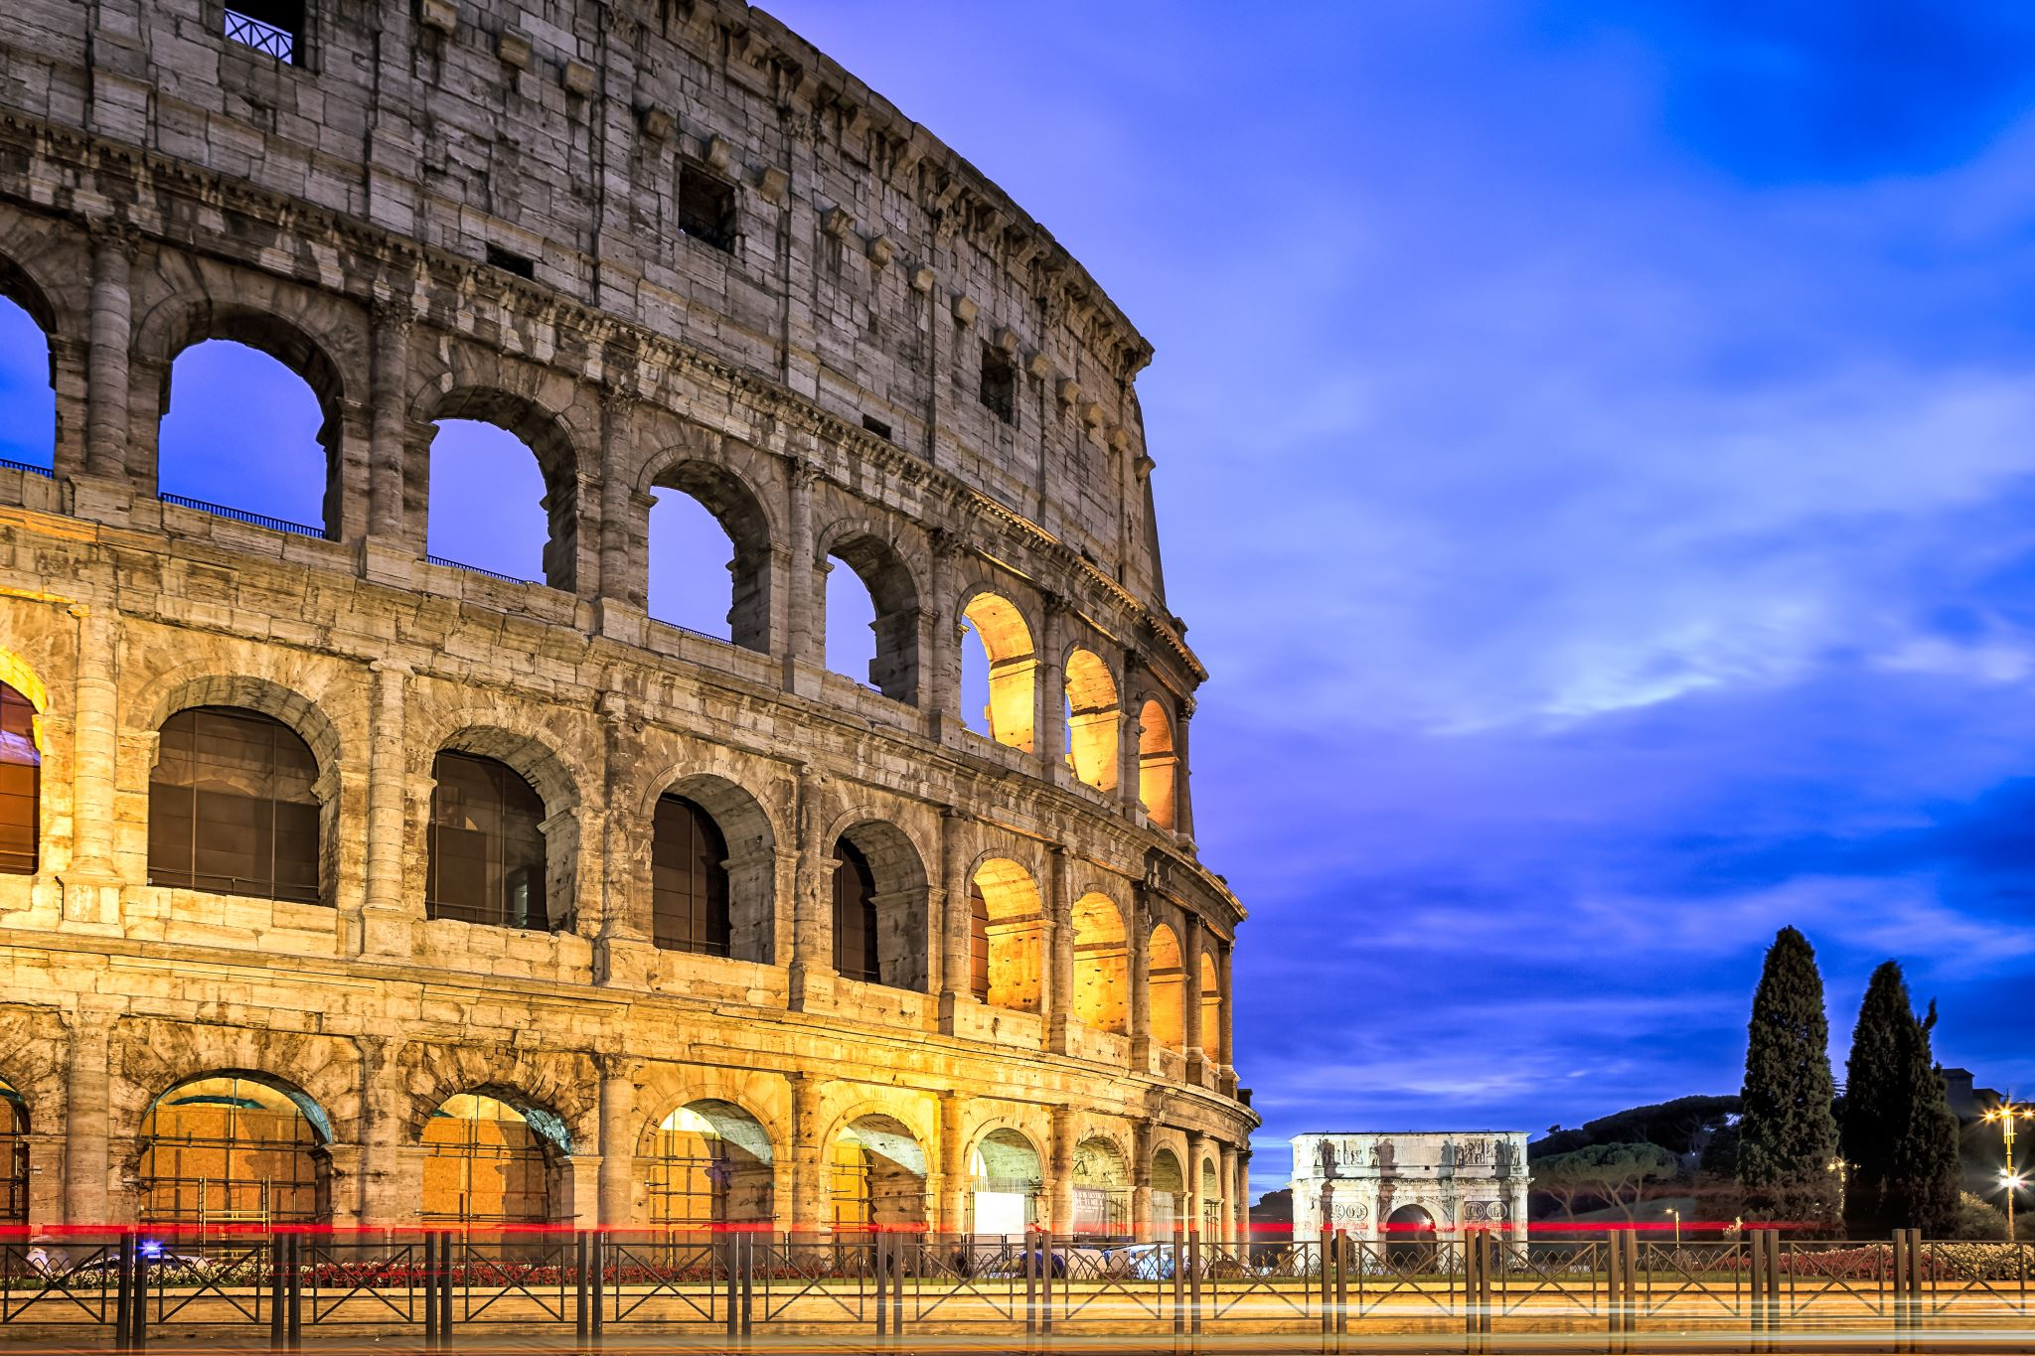
LATIN
Latin I
Latin II
Latin III
AP Latin IV
One teacher all four years creates seamless continuity between levels and students grow together like family
Latin great for all students, but especially those interested in careers in law, medicine or science in general
2-3 years of Latin helps to expand English vocabulary and refine speaking and writing
Learn all about Roman history, culture, mythology, ancient technology/innovation
Latin Club / Latin Honor Society (fun after school activities)
Participation in Area and State conventions and the National Latin Exam

Slide 9
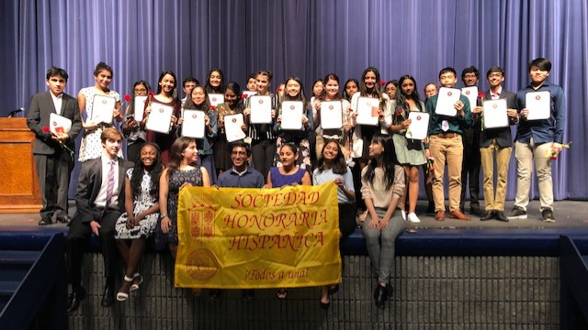
SPANISH
SPANISH I BASIC/INITIAL LEVEL
SPANISH II INTERMEDIATE LOW/MEDIUM LEVEL
SPANISH III INTERMEDIATE MEDIUM
SPANISH III AAC INTERMEDIATE MEDIUM/HIGH LEVEL
SPANISH IV AP INTERMEDIATE HIGH TO ADVANCE LEVEL
SPANISH V AP ADVANCE LEVEL
* SPANISH CLUB

